Slide 1


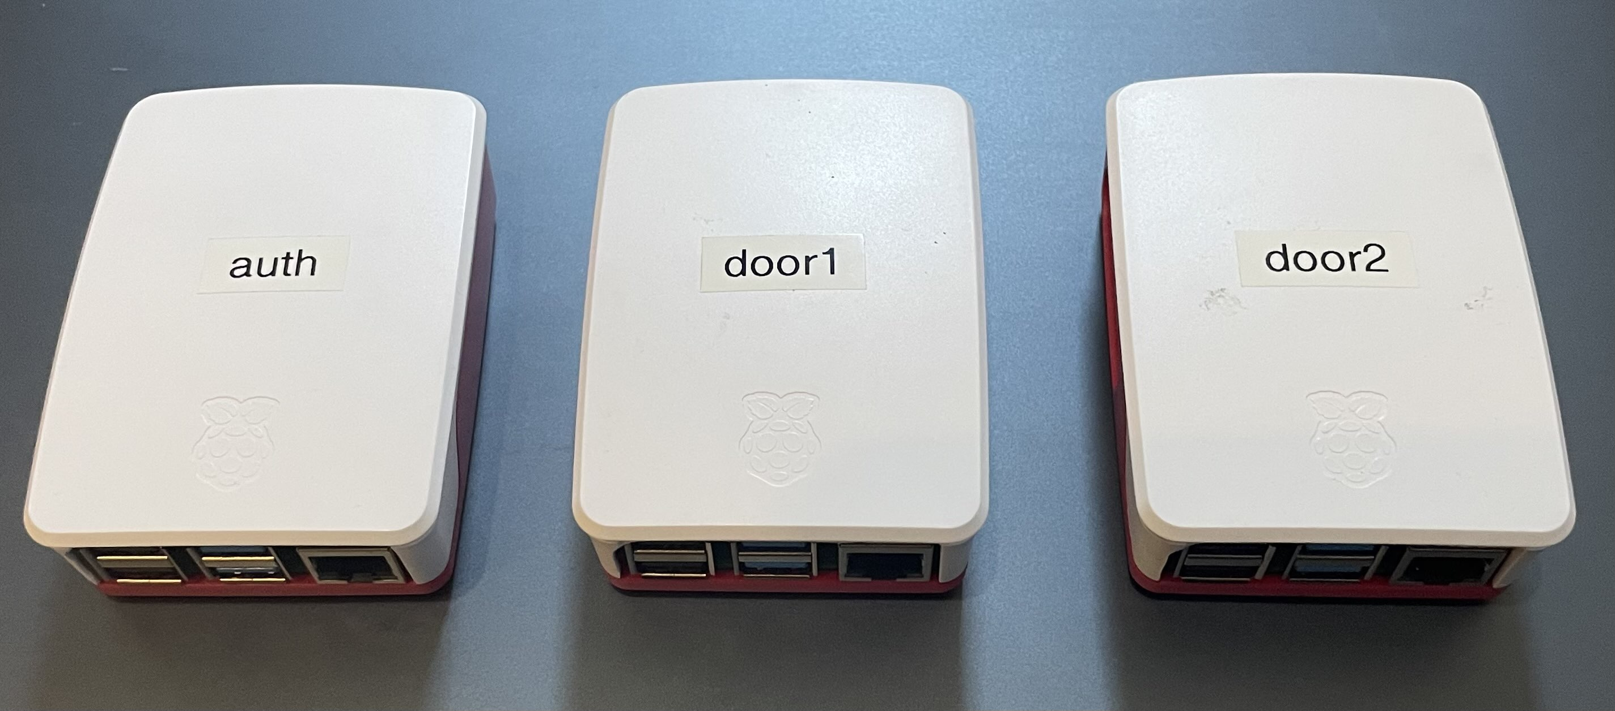
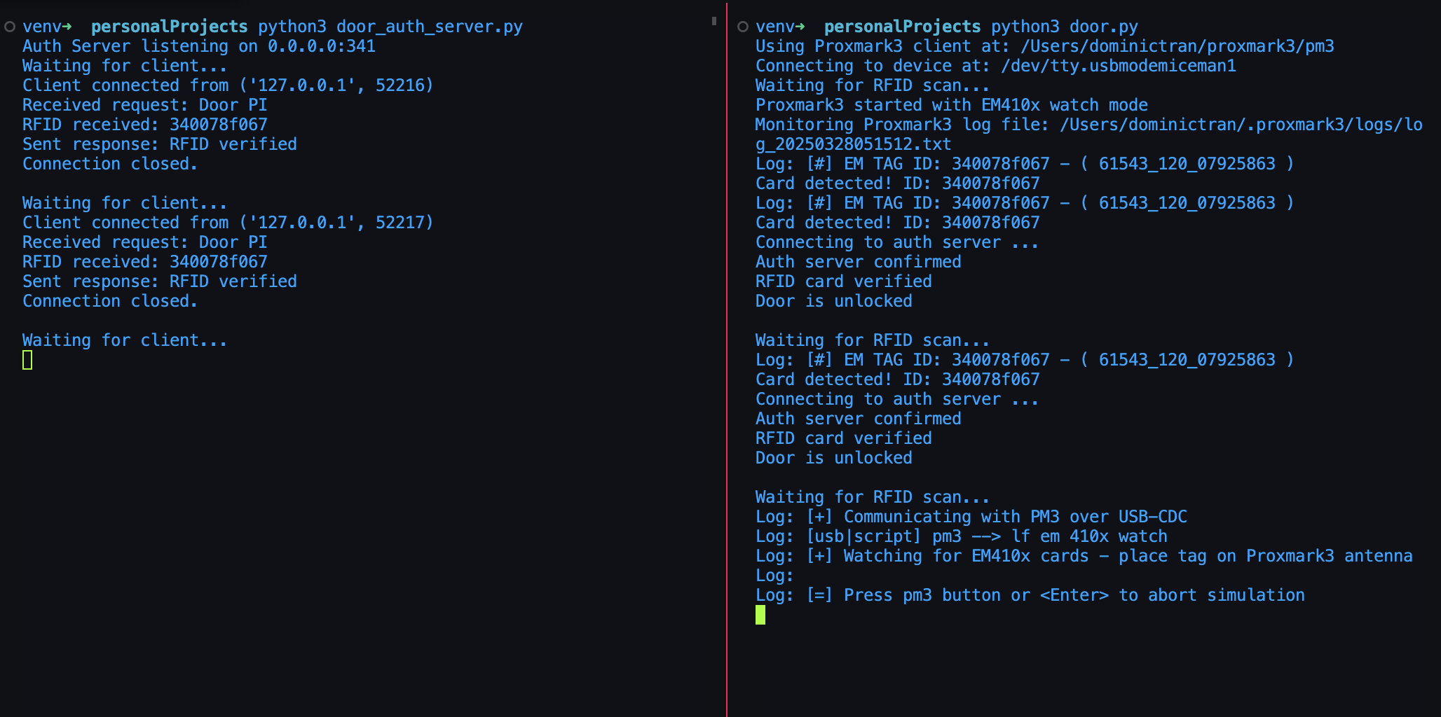
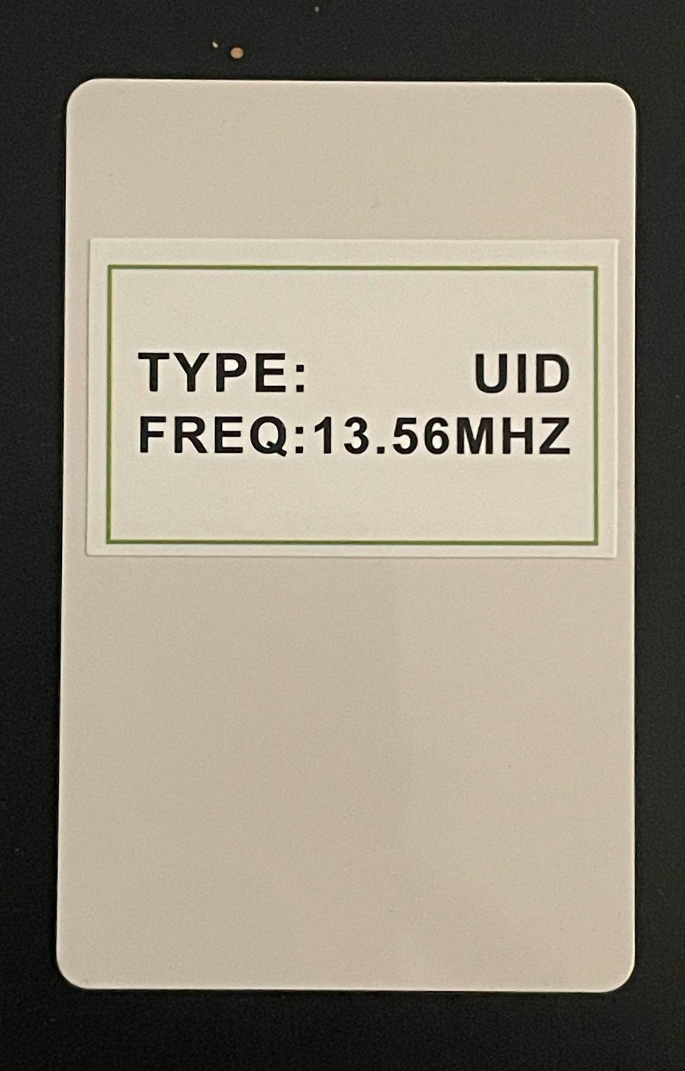

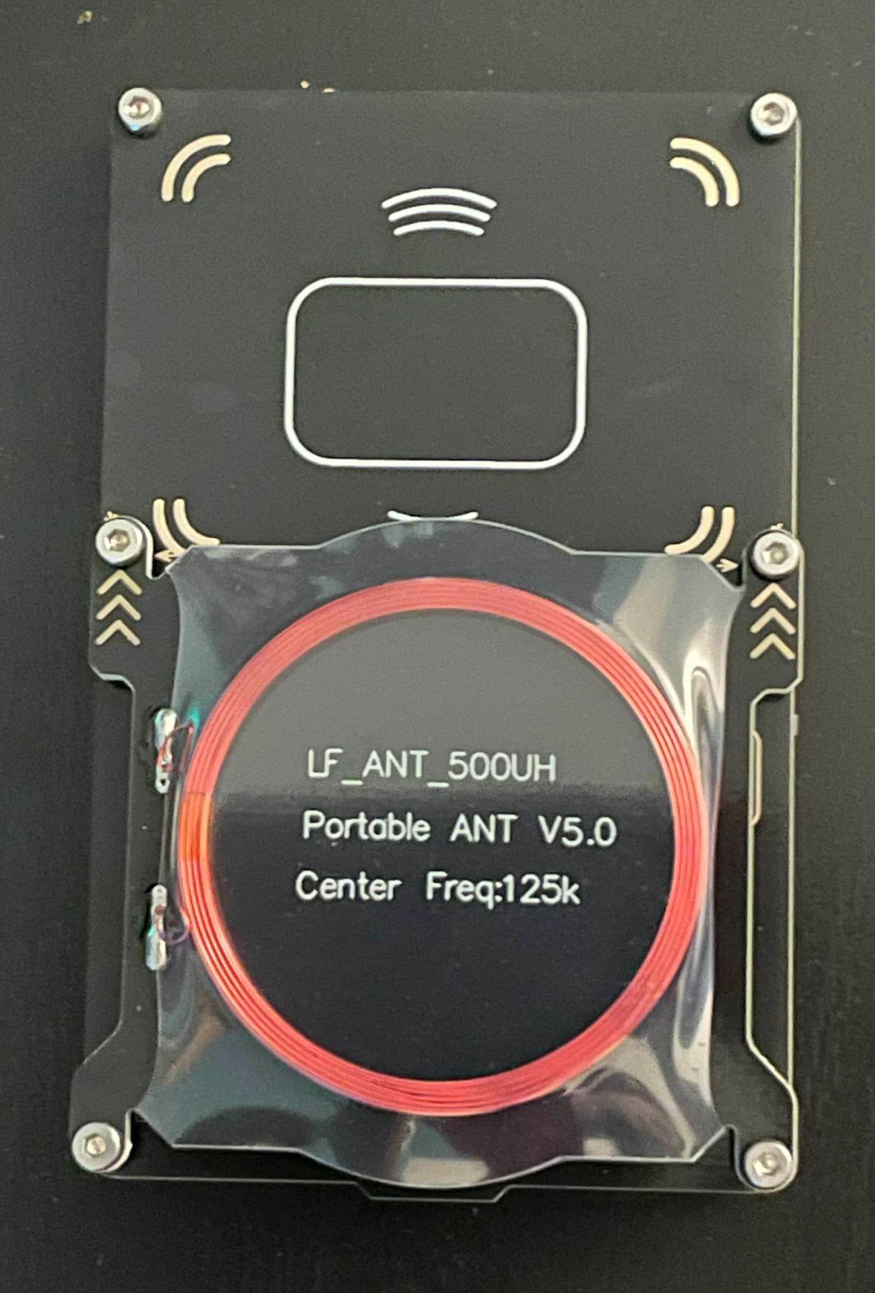

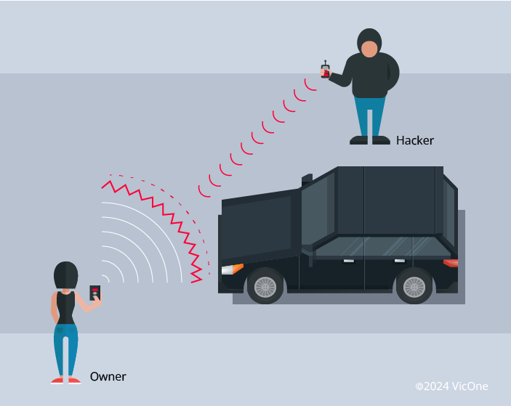
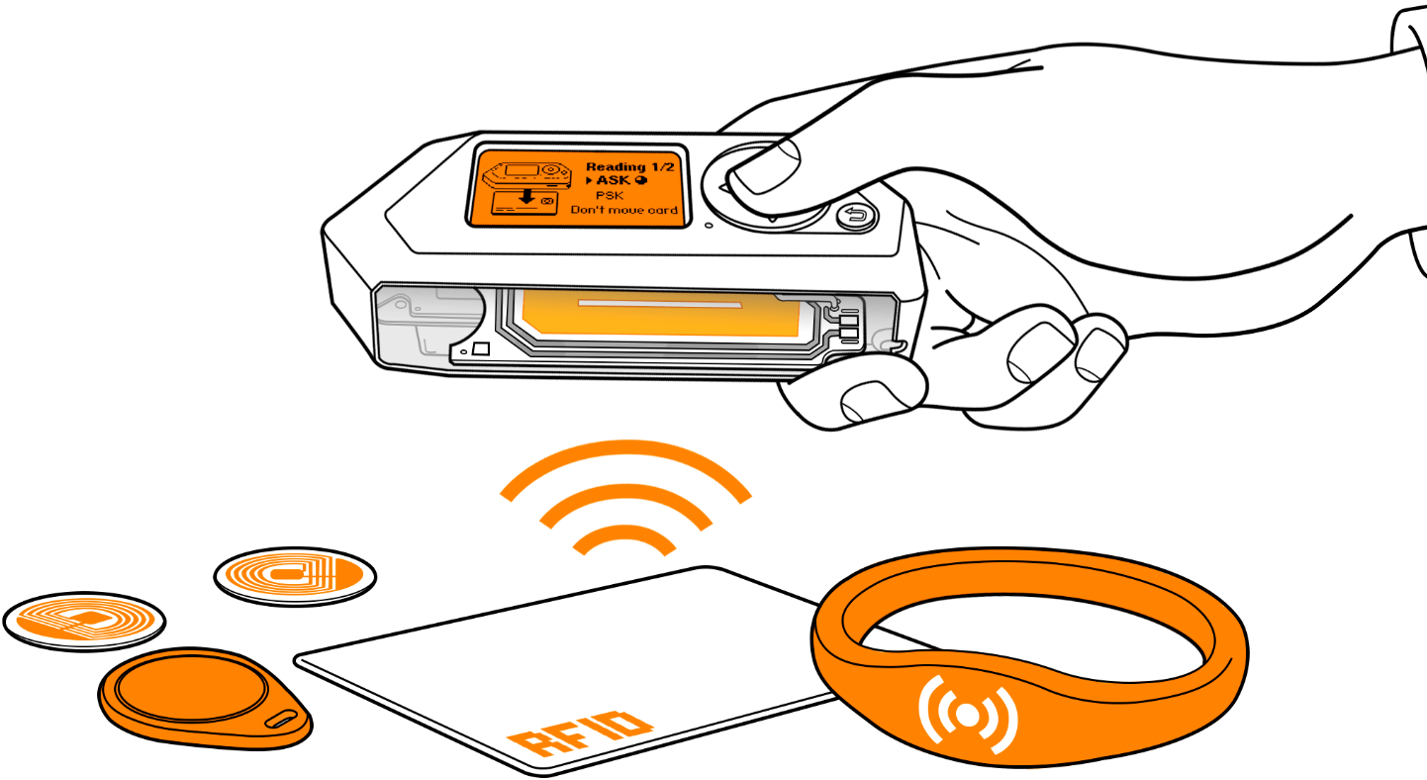
25-341
RFID Attack Detection
Team members: Chris Malatesta, Calvin Hurlbert, Jaspreet Singh, Keith Tran | Faculty adviser: Milos Manic | Sponsor: Idaho National Laboratory | Mentor: Bjorn Vaagensmith
Motivation
Tools
Solution
RFID attacks have become not only easy to carry out but are also almost impossible to detect without special equipment.
Using Raspberry pi’s to run servers, we can host a testbed to run attacks through.
We have software communicating with Zeek to help visualize traffic coming through the RFID scanner. We also compare the active traffic to a known baseline to detect potential threats to the network.
Attacks
We can streamline attacks with a Flipper Zero running through a Proxmox
There are many types of attacks out there and we will be focusing on two, denial of service and brute force.

